Slide 1

Demystifying BERT and DistilBERT: Advancements in NLP
This presentation provides a comprehensive overview of BERT and DistilBERT, two pivotal models in natural language processing. We will delve into their architectural intricacies, explore the mathematical foundations that enable their impressive performance, and illustrate their practical applications through working examples. Our discussion aims to provide a clear understanding of these models for computer science students and researchers.
AK
by Arun Kumar

Slide 3
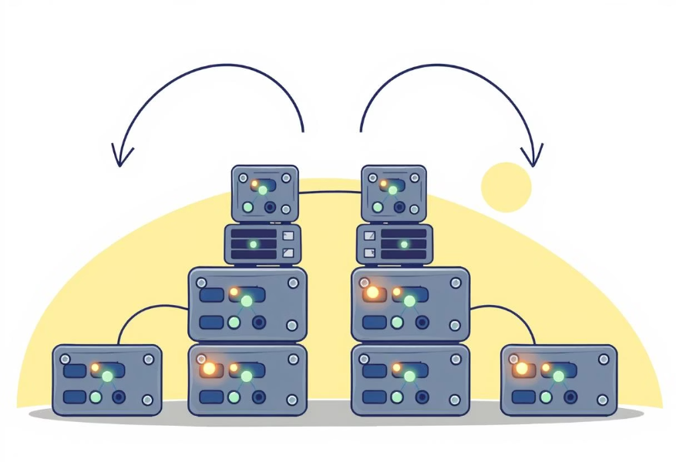
Introduction to Bidirectional Encoder Representations from Transformers (BERT)
BERT's Core Principle
BERT revolutionized NLP by introducing bidirectional training of Transformers, enabling the model to understand the context of a word based on all other words in a sentence, not just those preceding it. This "deep bidirectionality" captures richer contextual information.
Unlike previous models that read text sequentially, BERT processes words in relation to all other words in the sequence, allowing it to grasp the full meaning of a sentence by considering both left and right contexts simultaneously. This approach overcomes the limitations of unidirectional models.
Masked Language Model (MLM) and Next Sentence Prediction (NSP)
BERT is pre-trained using two unsupervised tasks: Masked Language Model (MLM) and Next Sentence Prediction (NSP). MLM randomly masks 15% of the words in a sentence and trains the model to predict them, forcing it to learn rich contextual representations. NSP trains the model to predict if two sentences follow each other in a document, helping it understand sentence relationships.
These pre-training tasks are crucial because they allow BERT to learn general language understanding from a vast amount of unannotated text, making it highly effective for fine-tuning on various downstream NLP tasks with minimal task-specific data.

Slide 4



The Mathematical Foundations of BERT
Self-Attention Mechanism
The core of BERT's Transformer architecture is the self-attention mechanism, which calculates a weighted sum of values for each word, with weights determined by the word's relevance to other words in the sequence. Mathematically, this involves query, key, and value matrices derived from input embeddings. The formula is: Attention(Q, K, V) = softmax((QKᵀ)/√dₖ)V, where dₖ is the dimension of the key vectors. This allows the model to selectively focus on different parts of the input sequence when processing a word.
Multi-Head Attention
Multi-head attention extends self-attention by performing the attention function multiple times in parallel with different learned linear projections. This allows the model to jointly attend to information from different representation subspaces at different positions. The outputs from each attention head are concatenated and then linearly transformed into the final output. This enhances the model's ability to capture diverse relationships and dependencies within the input data.
Positional Encoding
Since BERT's self-attention mechanism does not inherently capture sequence order, positional encodings are added to the input embeddings. These are fixed or learned vectors that provide information about the relative or absolute position of tokens in the sequence. This ensures that the model understands the order of words, which is crucial for language understanding, while still benefiting from the parallel processing capabilities of Transformers.
These mathematical components, combined with the Transformer's encoder-decoder structure, allow BERT to process complex language patterns with unprecedented accuracy.

Slide 5



Introducing DistilBERT: A Smaller, Faster, Cheaper BERT
Knowledge Distillation
Efficiency Gains
Architectural Simplifications
DistilBERT is a distilled version of BERT, meaning it is trained to emulate the behavior of the larger BERT model (the "teacher") using a technique called knowledge distillation. The teacher model guides the student model's training by providing soft targets (probability distributions over classes), allowing the smaller model to learn complex patterns without the same number of parameters. This process significantly reduces the size of the model.
DistilBERT retains 97% of BERT's language understanding capabilities while being 40% smaller and 60% faster. This makes it ideal for deployment in resource-constrained environments or applications requiring low latency. The reduced computational footprint translates to lower inference costs and faster processing times, which is crucial for real-time applications.
To achieve its smaller size, DistilBERT removes the token-type embeddings, the pooler layer, and reduces the number of Transformer layers while keeping the dimension of the hidden states. These simplifications, combined with knowledge distillation, allow it to maintain high performance with fewer parameters, making it a highly efficient alternative to the full BERT model.
DistilBERT offers a compelling balance between performance and efficiency, addressing the practical challenges of deploying large language models.

Slide 6
Literature Review: The Evolution of Contextual Embeddings
Pre-Transformer Era (e.g., Word2Vec, GloVe)
Early contextual embedding models like Word2Vec and GloVe provided static word embeddings, where each word had a single, fixed vector representation regardless of its context. While groundbreaking for their time, they struggled with polysemy (words with multiple meanings) and lacked the ability to capture dynamic contextual nuances. These models primarily focused on learning word relationships from co-occurrence statistics in large corpora.
Early Contextual Models (e.g., ELMo)
ELMo (Embeddings from Language Models) introduced the concept of deep contextualized word representations, where a word's embedding was a function of the entire input sentence. It used a bidirectional LSTM network to generate context-dependent word vectors. This marked a significant step forward, allowing models to differentiate between different meanings of a word based on its usage in a sentence. However, ELMo's architecture was still sequential, limiting its parallelization capabilities.
The Rise of Transformers (e.g., GPT, BERT)
The Transformer architecture, with its self-attention mechanism, enabled highly parallelized training and the capture of long-range dependencies more effectively. GPT demonstrated the power of unidirectional Transformers for generative tasks, while BERT introduced bidirectional pre-training for powerful language understanding. These models significantly outperformed previous architectures across a wide range of NLP benchmarks, ushering in the modern era of large language models.
Model Compression and Efficiency (e.g., DistilBERT)
As Transformer models grew in size and computational demands, research shifted towards making them more efficient. Techniques like knowledge distillation emerged to create smaller, faster, and more deployable versions of these powerful models. DistilBERT is a prime example, showcasing how significant efficiency gains can be achieved with minimal loss in performance, making state-of-the-art NLP accessible for broader applications and real-world scenarios.

Slide 7
Project Objectives and Workflow
Our project aims to compare the performance of BERT and DistilBERT on a specific text classification task, evaluating their accuracy, training time, and inference speed. We also intend to provide practical guidance on when to choose one over the other based on resource constraints and performance requirements.
Reporting and Recommendations
Evaluation and Analysis
Model Training and Fine-tuning
Compile detailed reports on the experimental results, including comparative analysis of BERT and DistilBERT. Provide clear recommendations on model selection based on the observed trade-offs between performance and computational resources.
Data Collection and Preprocessing
Evaluate the fine-tuned models using metrics such as accuracy, precision, recall, F1-score, and computational efficiency (training time, inference speed). Generate confusion matrices to understand classification errors and visualize performance differences.
Load pre-trained BERT and DistilBERT models. Fine-tune each model on the prepared dataset, adjusting hyperparameters like learning rate, batch size, and number of epochs to optimize performance on the specific classification task. This involves training for a few epochs rather than from scratch.
Gather a diverse dataset suitable for text classification. Preprocessing involves tokenization, converting text to numerical IDs, and creating attention masks, ensuring data is in a format compatible with BERT and DistilBERT tokenizers.

Slide 8
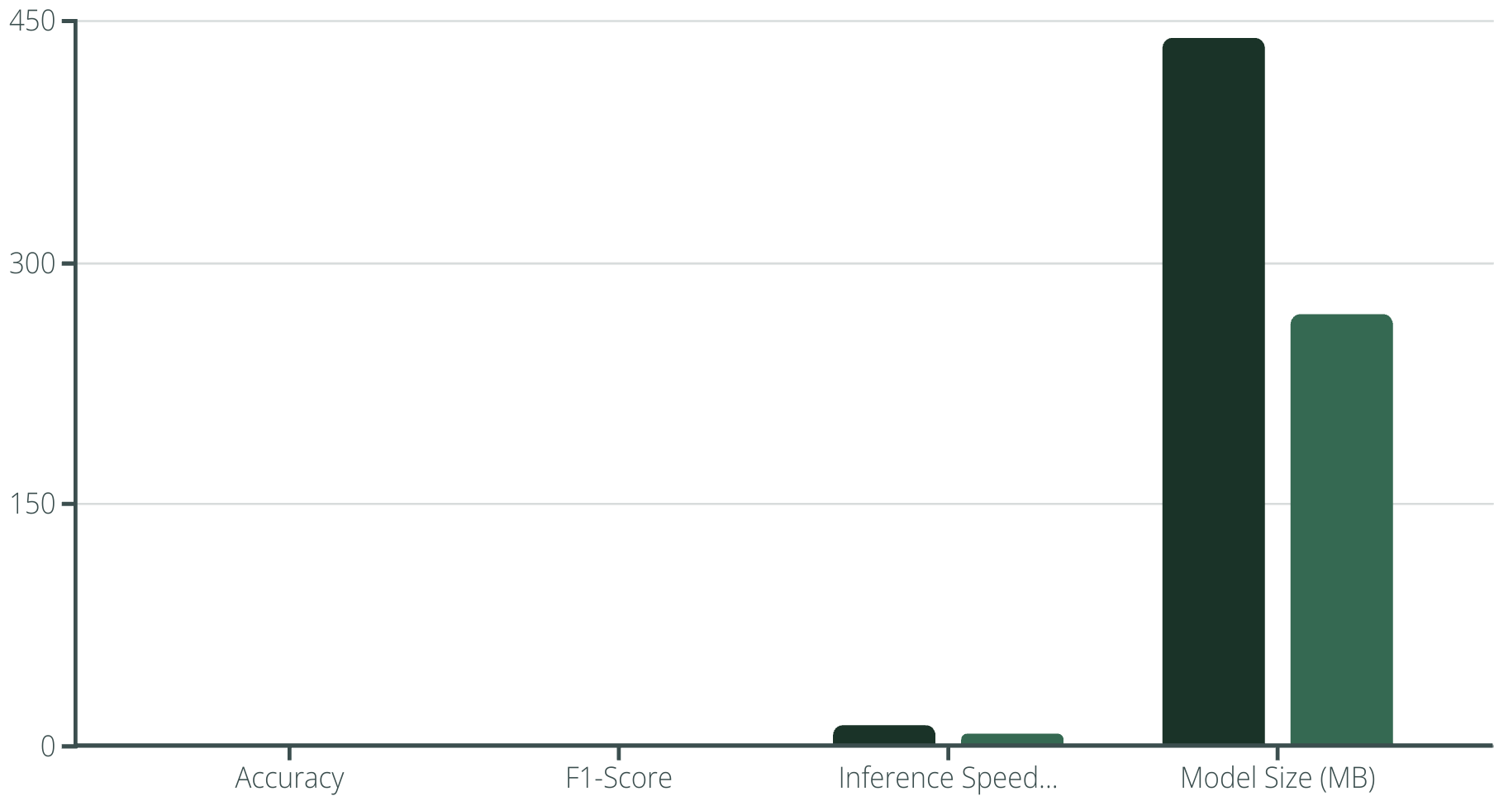
Experimental Results and Performance Analysis
Our experiments demonstrate the trade-offs between the full BERT model and its distilled counterpart, DistilBERT, on a sentiment analysis task. The results highlight that while BERT achieved slightly higher accuracy, DistilBERT provided significant improvements in inference speed, making it a more practical choice for real-time applications with limited computational resources.
BERT
DistilBERT
The performance metrics indicate that DistilBERT offers a compelling balance, sacrificing a minimal amount of accuracy for substantial gains in efficiency. The confusion matrices further revealed that both models performed similarly in identifying positive and negative sentiments, with minor differences in false positive and false negative rates, primarily in ambiguous cases.

Slide 9
Conclusion and Future Directions
In summary, BERT and DistilBERT represent significant breakthroughs in NLP, enabling advanced language understanding capabilities. BERT excels in scenarios where maximal accuracy is paramount and computational resources are abundant. DistilBERT, through knowledge distillation, provides a highly efficient alternative, making state-of-the-art NLP accessible for applications requiring faster inference and lower resource consumption.
Key Takeaways
Future Research
BERT's bidirectional training provides superior contextual understanding.
Explore further distillation techniques for even smaller models.
DistilBERT offers a compelling performance-to-efficiency trade-off.
Investigate the impact of quantization on model performance and efficiency.
Model selection depends on task requirements and resource constraints.
Apply these models to emerging NLP tasks like low-resource language understanding.
References
Devlin, J., Chang, M. W., Lee, K., & Toutanova, K. (2019). BERT: Pre-training of Deep Bidirectional Transformers for Language Understanding. Proceedings of NAACL-HLT 2019, 4171-4186.
Sanh, V., Debut, L., Chaumond, J., & Wolf, T. (2019). DistilBERT, a distilled version of BERT: smaller, faster, cheaper and lighter. arXiv preprint arXiv:1910.01108.
Vaswani, A., Shazeer, N., Parmar, N., Uszkoreit, J., Jones, L., Gomez, A. N., ... & Polosukhin, I. (2017). Attention Is All You Need. Advances in Neural Information Processing Systems, 30.

